Slide 1

Logistic Regression
Damascus University
ML class
Machine Learning

Slide 2
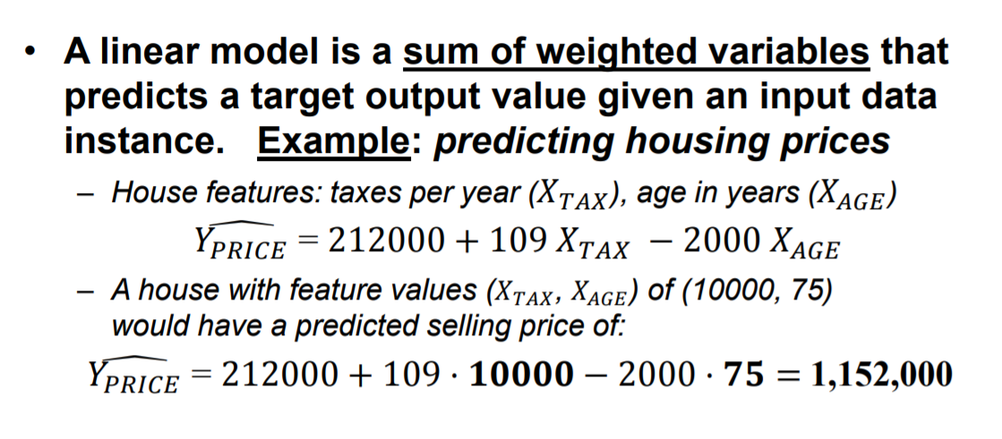
Linear models

Slide 3
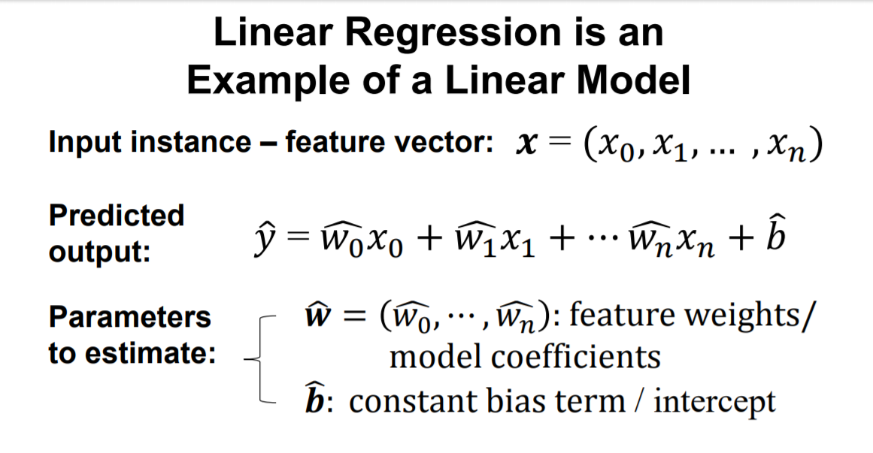

Slide 4
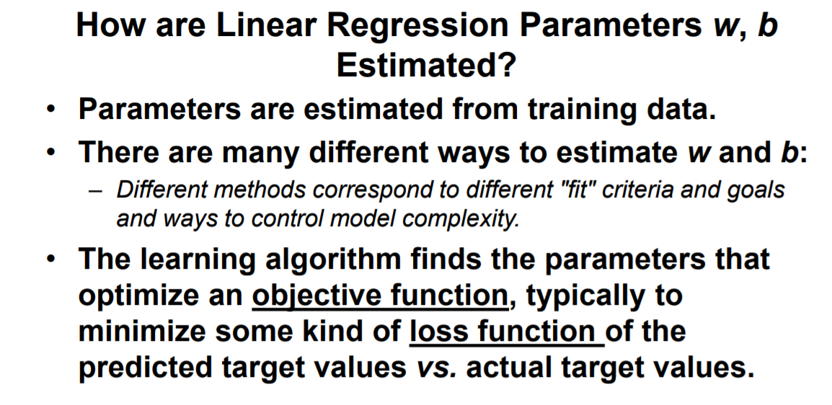

Slide 5
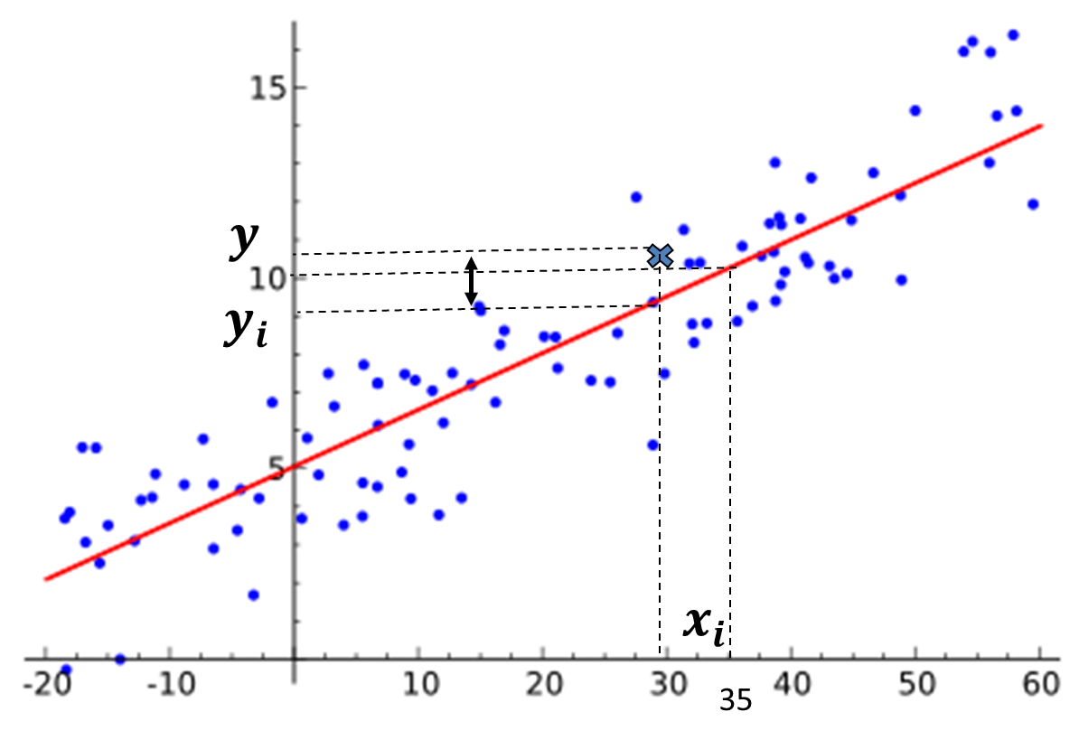
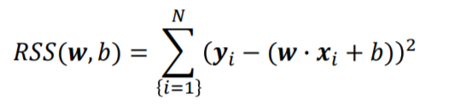
Least-Squares Linear Regression
Finds wieghts w and bais b that minimizes the mean squared error of the linear model:
i.e. the sum of squared differences between predicted target and actual target values.
No parameters to control model complexity.

Slide 6
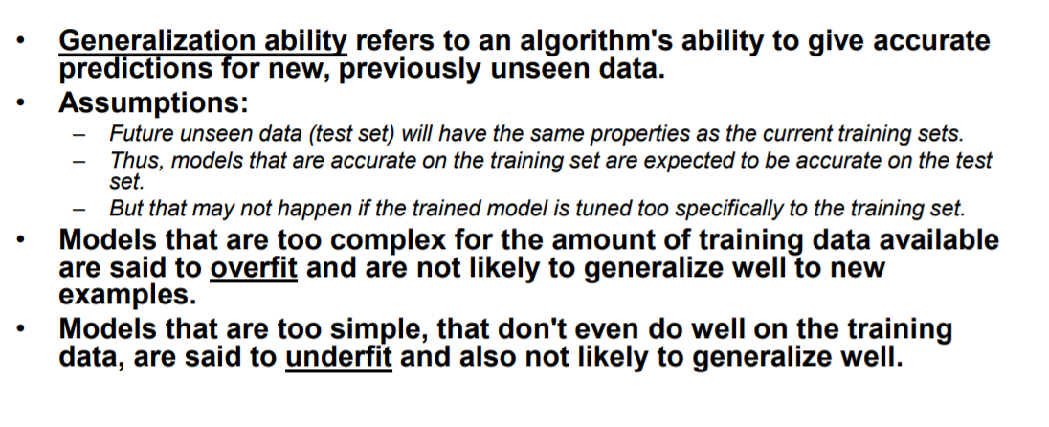
Generalization, Overfitting, and Underfitting

Slide 7
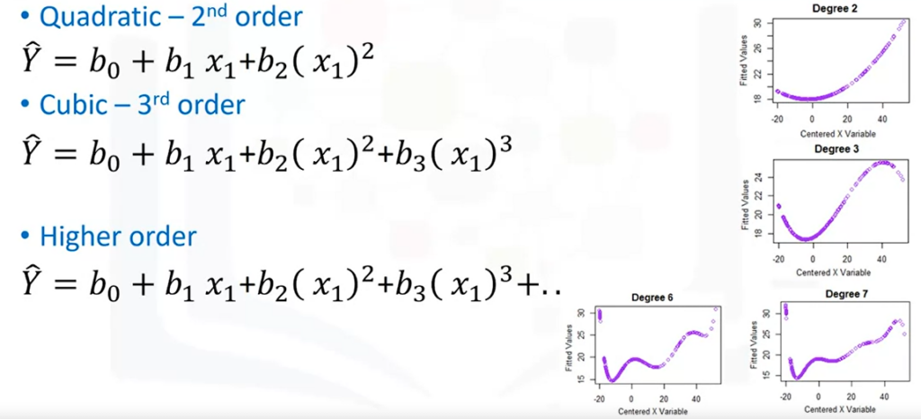
Polynomial regression
Linear Models can be too simple (underfitting)
Generate new features consisting of all polynomial combinations of the original features

Slide 8
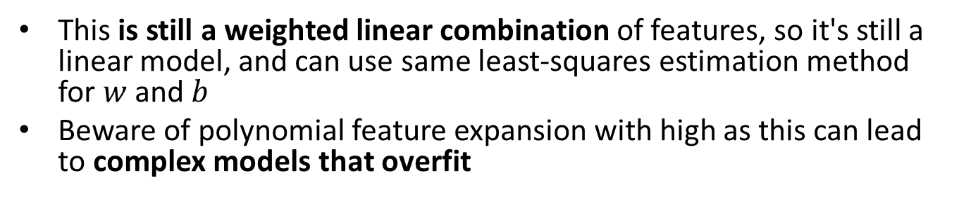
Polynomial regression
This is still a weighted linear combination of features, so it's still a linear model, and can use same least-squares estimation method for $w$ and $b$
Beware of polynomial feature expansion with high as this can lead to complex models that overfit

Slide 9

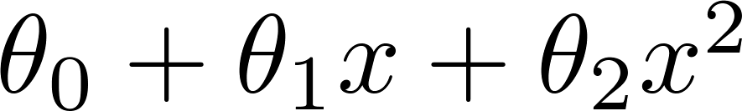
The Problem of Overfitting
Linear Regression
Underfitting
Just right
Overfitting

Slide 10
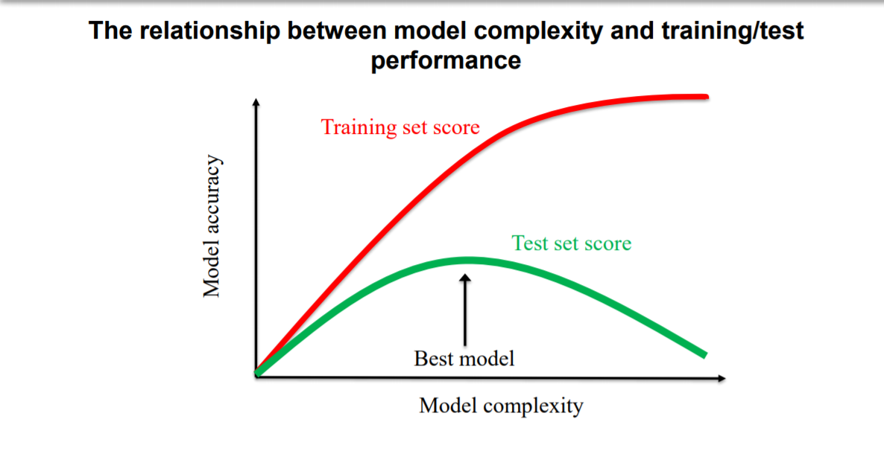

Slide 11
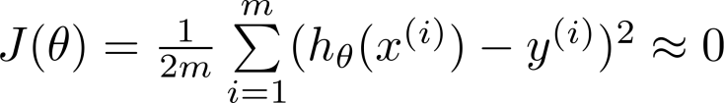
The Problem of Overfitting
If we have too many features (original or polynomial)
the learned hypothesis may fit the training set very well ( ), but fail to generalize to new examples (predict prices on new examples).
What to do?
Reduce number of features
Regularization.
Notes:
Reduce number of features.
Manually select which features to keep.
Model selection algorithm (later in course).
Regularization.
Keep all the features, but reduce magnitude/values of parameters .
Works well when we have a lot of features, each of which contributes a bit to predicting .

Slide 12
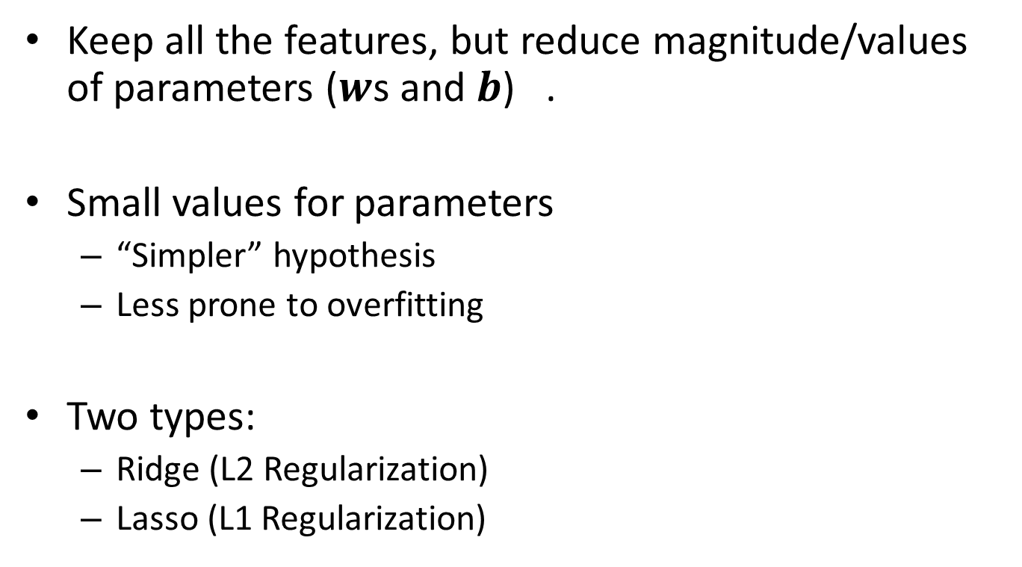
Regularization
Keep all the features, but reduce magnitude/values of parameters ($w$s and $b$) .
Small values for parameters
“Simpler” hypothesis
Less prone to overfitting
Two types:
Ridge (L2 Regularization)
Lasso (L1 Regularization)

Slide 13
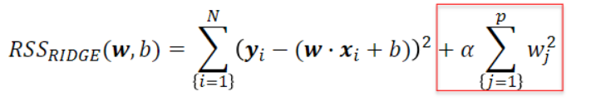
Ridge Regularization
Ridge regression learns w, busing the same least-squares criterion but adds a penalty for large variations in w parameters
Regularization prevents overfitting by restricting the model, typically to reduce its complexity.
Ridge regression uses L2 regularization: minimize sum of squares of w entries
The influence of the regularization term is controlled by the alpha parameter.
Higher alpha means more regularization and simpler models

Slide 14
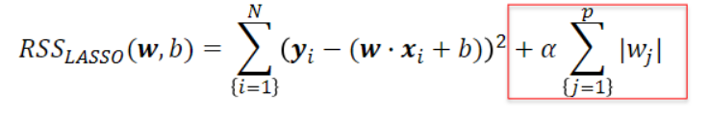
Lasso Regularization
Lasso regression is another form of regularized linear regression that uses an L1 regularization penalty for training (instead of ridge's L2 penalty) L1 penalty: Minimize the sum of the absolute values of the coefficients
This has the effect of setting parameter weights in w to zero for the least influential variables
This is called a sparse solution: a kind of feature selection
The parameter alpha controls amount of L1 regularization (default = 1.0).
The prediction formula is the same as ordinary least-squares.

Slide 15
When to use ridge vs lasso regression:
Many small/medium sized effects: use ridge.
Only a few variables with medium/large effect: use lasso.

Slide 16
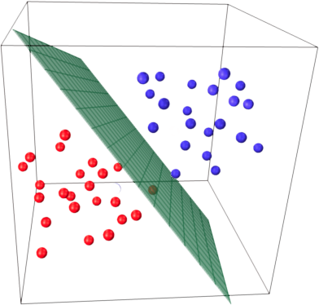
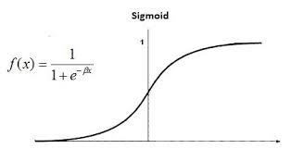
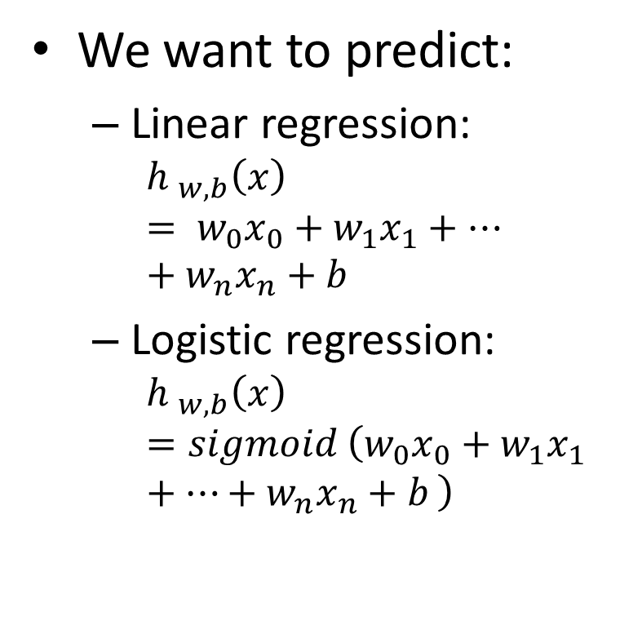
Linear models for classification Logistic Regression
We want to predict:
Linear regression:
$${h }_{w,b}\left(x\right)= w_{0}x_{0}+w_{1}x_{1}+…+w_{n}x_{n}+b$$
Logistic regression:
$${h }_{w,b}\left(x\right)=sigmoid \left(w_{0}x_{0}+w_{1}x_{1}+…+w_{n}x_{n}+b \right)$$
Notes:
Why sigmoid? Value between 0 and 1
Means probability of y=1 given x, parameterized by $θ$

Slide 17
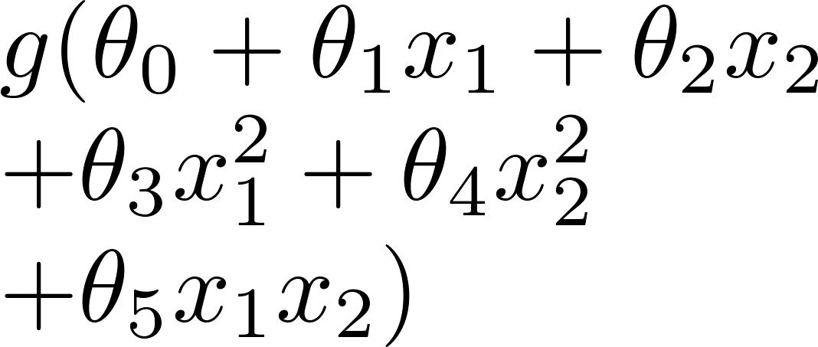
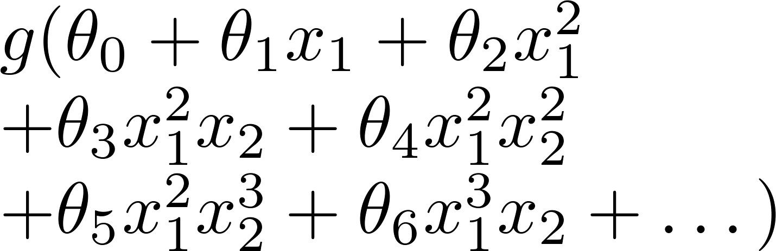
Logistic Regression: Regularization
Underfitting
Just right
Overfitting
x₂
x₂
x₂
x₁
x₁
x₁
( g = sigmoid function)
L2 regularization is 'on' by default (like ridge regression)
Parameter C controls amount of regularization (default 1.0)
smaller C specify stronger regularization.

Slide 18
Notebooks
Supervised Learning with sikit-learn (Linear Regression + Logistic Regression)

